Slide 1

ITI122 Assignment
GenAI Prototype Presentation
Team 9
Zhu Qihui, Oscar (9801937V)
Goh Leng Guan (2778807Y)
Teo Thye Soon, Eddie (3897044T)

Slide 2
Problem Analysis
Manual loan assessment is slow, inconsistent, and difficult to scale. Policies change constantly, and outcomes often depend on the evaluator’s experience.
Customers rarely receive clear explanations, leading to low transparency and trust.
There is a clear need for an automated and explainable loan assessment system.

Slide 3
Pain Points, Inefficiencies, and Bottlenecks
Manual cross-referencing across multiple systems
Customer profile, account status, and credit score may sit in different screens or systems.
Officers repeatedly copy/paste or re-enter values, increasing the chance of mismatches (wrong customer record, outdated credit score).
Policy interpretation is repetitive and error-prone
Mapping “credit score band + account status → risk level + interest rate” is a structured task, but done manually.
Errors occur when staff misread tables, use the wrong version of a policy document, or overlook a condition.

Slide 4
Pain Points, Inefficiencies, and Bottlenecks
Inconsistent application of judgment and overrides
Even when policies are clear, staff may interpret edge cases differently (e.g., borderline credit score, closed accounts, delinquency history).
Override rules (such as nationality/PR conditions) can be missed, applied late, or inconsistently documented.
Delays caused by verification and back-and-forth
Waiting for credit bureau pulls, manager reviews, exception approvals, or missing documents slows throughput.
Applications can sit idle while staff clarify what policy applies or seek concurrence.

Slide 5
Pain Points, Inefficiencies, and Bottlenecks
Weak transparency and explainability for customers
Even when the decision is correct, the explanation is often brief or generic (“did not meet criteria”).
Staff may struggle to produce a clear, consistent explanation tied to policy factors, especially under time pressure.
High operational load during peak periods
During high application volume, repetitive checks become a bottleneck.
Quality drops when officers multitask, leading to increased rework, escalations, or customer complaints.

Slide 6
Pain Points, Inefficiencies, and Bottlenecks
Where Human Judgment, Manual Work, and Delays Typically Occur
Human judgment: interpreting edge cases, applying overrides/exceptions, deciding “Proceed with Caution” vs “Rejected,” crafting explanations.
Repetitive manual work: retrieving profile fields, reading policy tables, mapping ranges, documenting justification notes.
Delays: waiting for credit bureau data, policy clarification, exception approval, missing documents, and internal review queues

Slide 7
Our System – Loan Risk Assessment
Gen-AI powered Loan Risk Assessment prototype.
Our system automatically pulls customer information, reads the bank’s policy documents, and then applies the rules to produce a clear risk level, interest rate, and eligibility decision — without guessing or making assumptions.

Slide 8
Our System – Loan Risk Assessment
Targeted Workflow Steps
The proposed solution targets the most repetitive and error-prone stages of the current workflow.
First, customer profile retrieval is automated to eliminate manual lookups and data re-entry.
Second, policy interpretation is automated to ensure consistent mapping of credit score and account status to risk level and interest rate.
Third, decision consolidation and override checks are centralised to prevent missed eligibility conditions.
Finally, explanation generation is automated to provide consistent, transparent justifications to customers and internal stakeholders. This mirrors a real-world banking decision pipeline where policy interpretation and approval are separated for audit and compliance purposes.

Slide 9
Our System – Loan Risk Assessment
Justification for Using GenAI
GenAI is appropriate for this use case because loan policies are typically written in human-readable documents rather than executable code.
GenAI can interpret policy content and apply it consistently without requiring extensive manual rule translation for every policy update

Slide 10
Our System – Loan Risk Assessment
Success Metrics/KPIs
Reduced Assessment Time: Average assessment time reduced from approximately 15 minutes to under 1 minute per case.
Decision consistency: 100% of tested loan decisions matched the expected outcomes derived from the official policy documents and decision rules during validation testing.

Slide 11
Setup
First built and tested the prototype on Flowise Cloud - easy to prototype quickly without setting up servers
Following by deploying built flowise agents on Render (Cloud Application Platform)
, using this public link: https://iti122assignmentteam9.onrender.com/
simulate how it could eventually run in a real production environment

Slide 12
Direct FlowiseAI vs FlowiseAI in Render
 | Direct FlowiseAI Cloud | FlowiseAI in Render Cloud (Chosen)
Purpose | Managed development and testing environment | Self-hosted production deployment
Cost (Starter Tier) | USD 35/month | USD7/month
Security and Access Control | Fixed configuration, limited customization | Full control over authentication, API keys, and data access – Application Security Provision
Deployment Speed | Slower (shared public infrastructure) | Faster (dedicated private instance)
Licence | Open-Source | commercial hosting platform

Slide 13
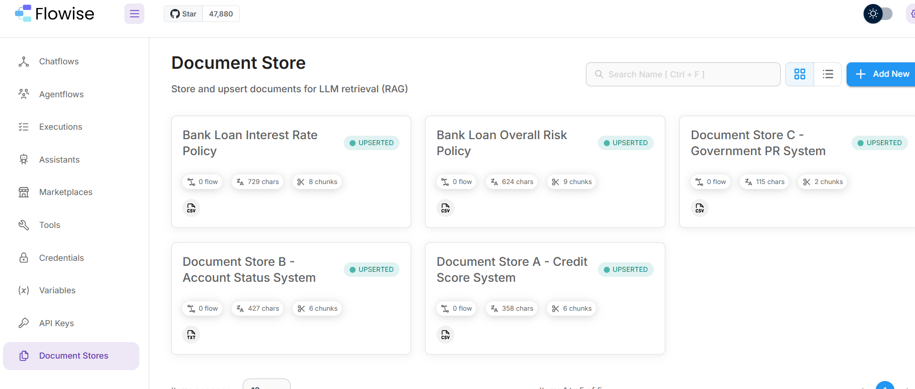
Document Store in Flowise – RAG Concept
(For Retrieval/Easy Updating)

Slide 14
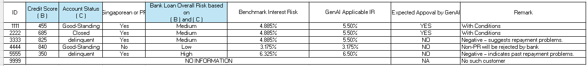
Our Sample Database (In Summary)
For Self-Verification

Slide 15
Governance AI
Transparency & Explainability
The system should clearly show how it reached a decision.
Users should understand key factors influencing outcomes (e.g., credit score, account status).
AI decisions must align with official bank policy documents.
Human Oversight (Human-in-the-Loop)
AI assists — it does not replace final decision makers.
Risky or unusual cases should be escalated to humans
Humans can override the AI if needed.

Slide 16
Limitations
Final approval still requires human judgment. (Human-in-the-loop)
Model is dependent on correctness of underlying documents.
More stress-case testing would be required in real production.

Slide 17
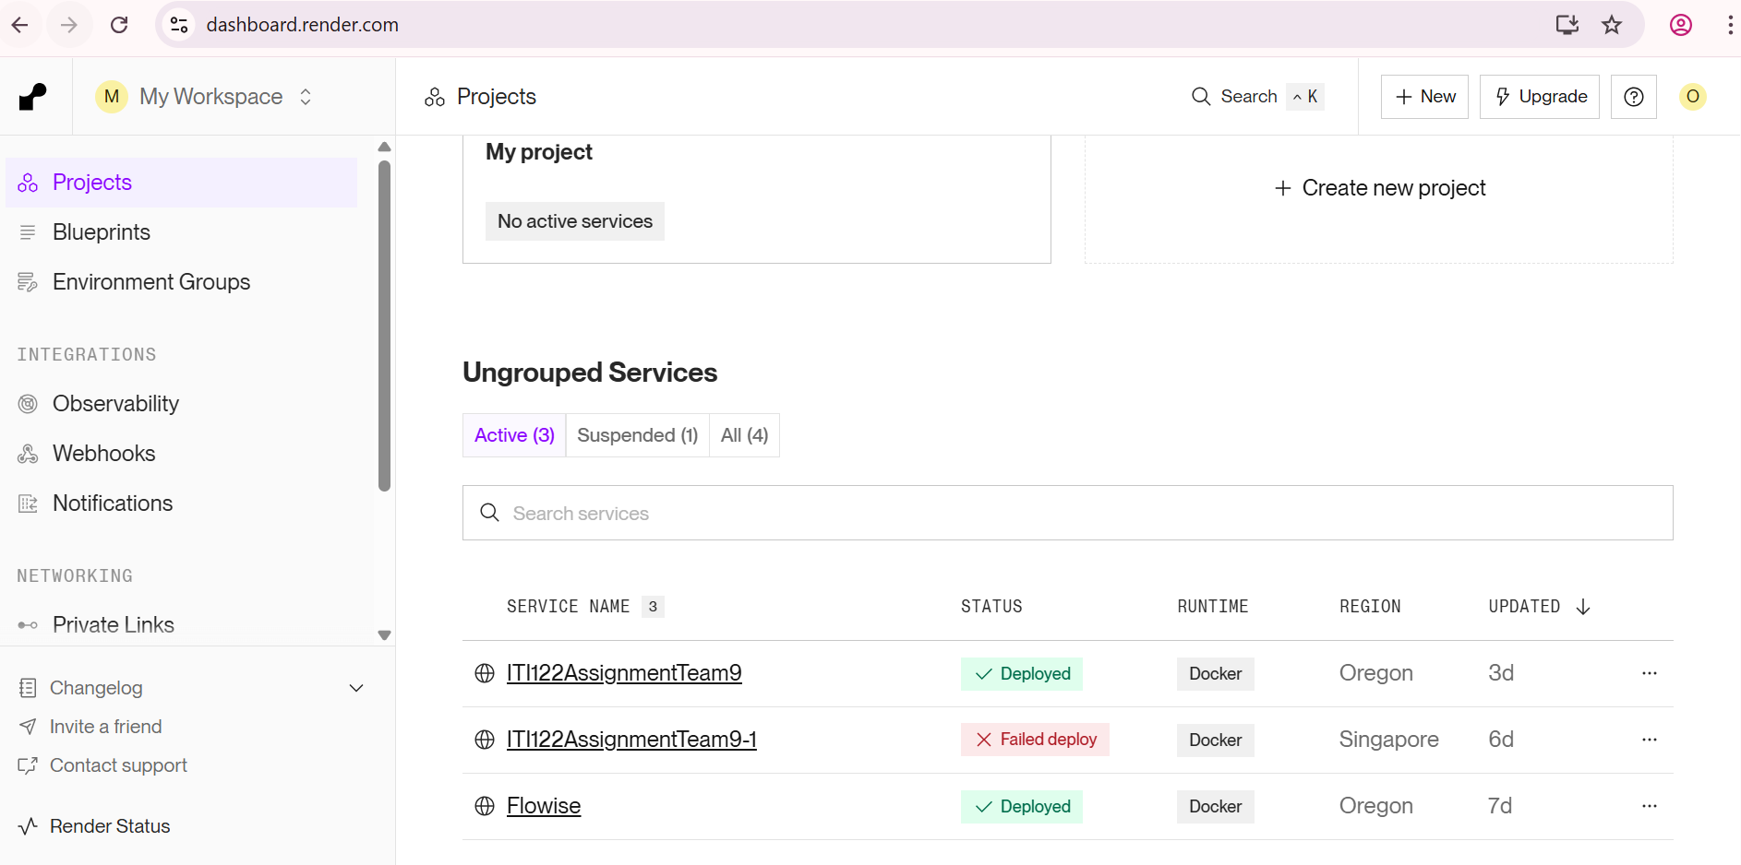
Server Deployment… @ Render

Slide 18
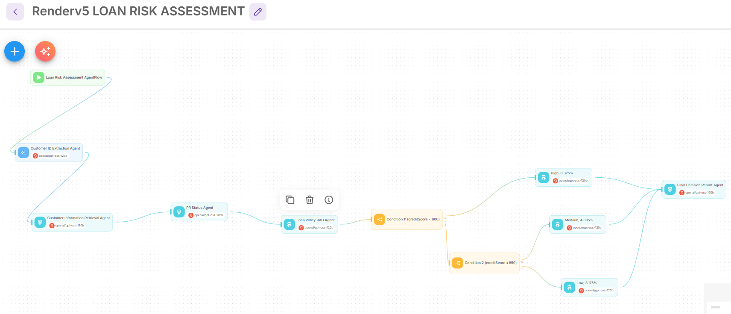
AgentFlow Overview

